Slide 1

Autopsy

Slide 2

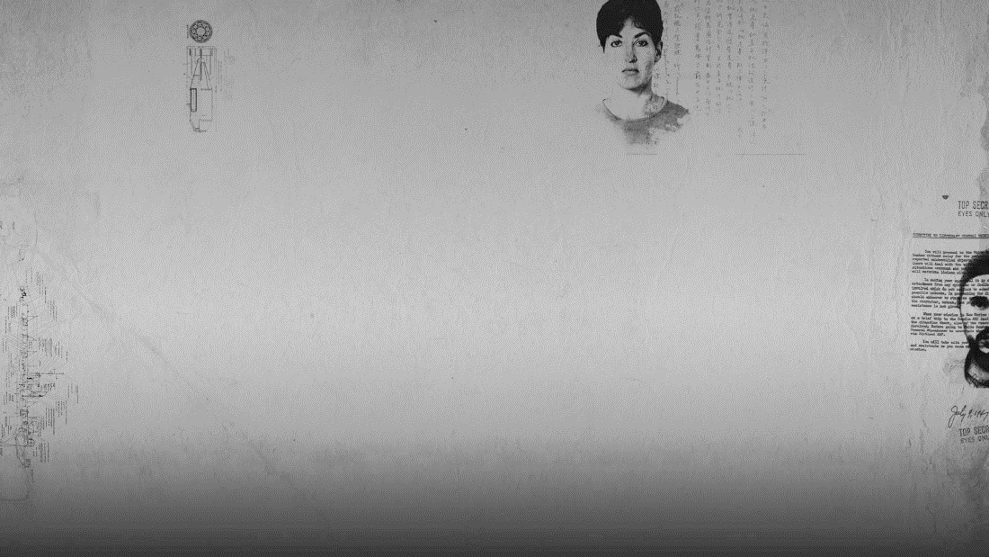
AUTOPSY
Digital forensics platform used by law enforcement and corporate examiners
Can be used to recover deleted photos from your camera's memory card
Primarily used to analyze hard-drives, disks, and computers to extract information about files and folders in those devices
Now it’s time to get your hands into autopsy!!
Notes:
-Used to investigate what happened on a computer

Slide 3
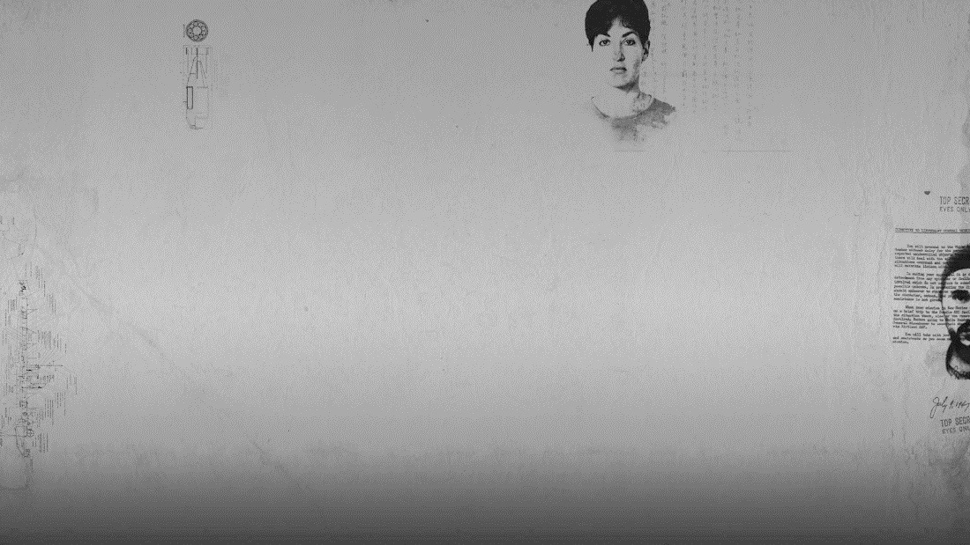

INSTRUCTIONS
Open your terminal and type – cd software/autopsy
On the following line type - sh unix_setup.sh
3. Now type- bin/autopsy
Now do you see a very very scary dog? Awesome !
Let’s start doing some detective work now!!!

Slide 4
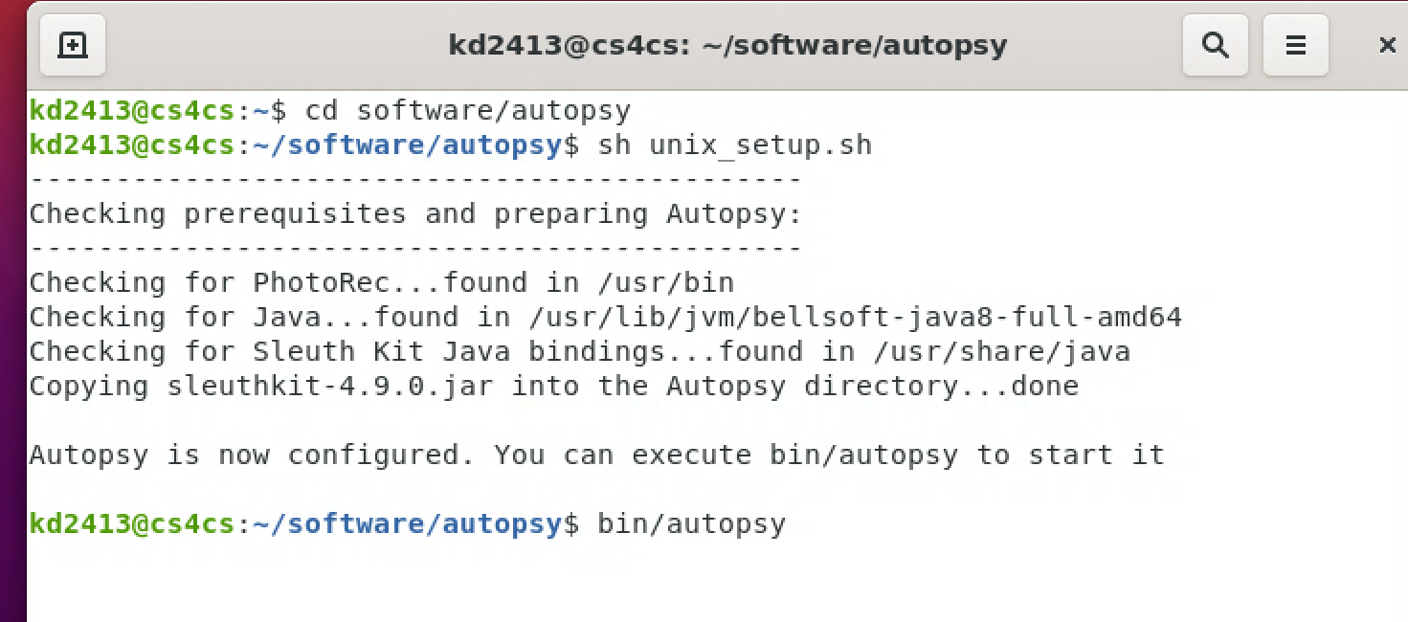
Opening Autopsy

Slide 5
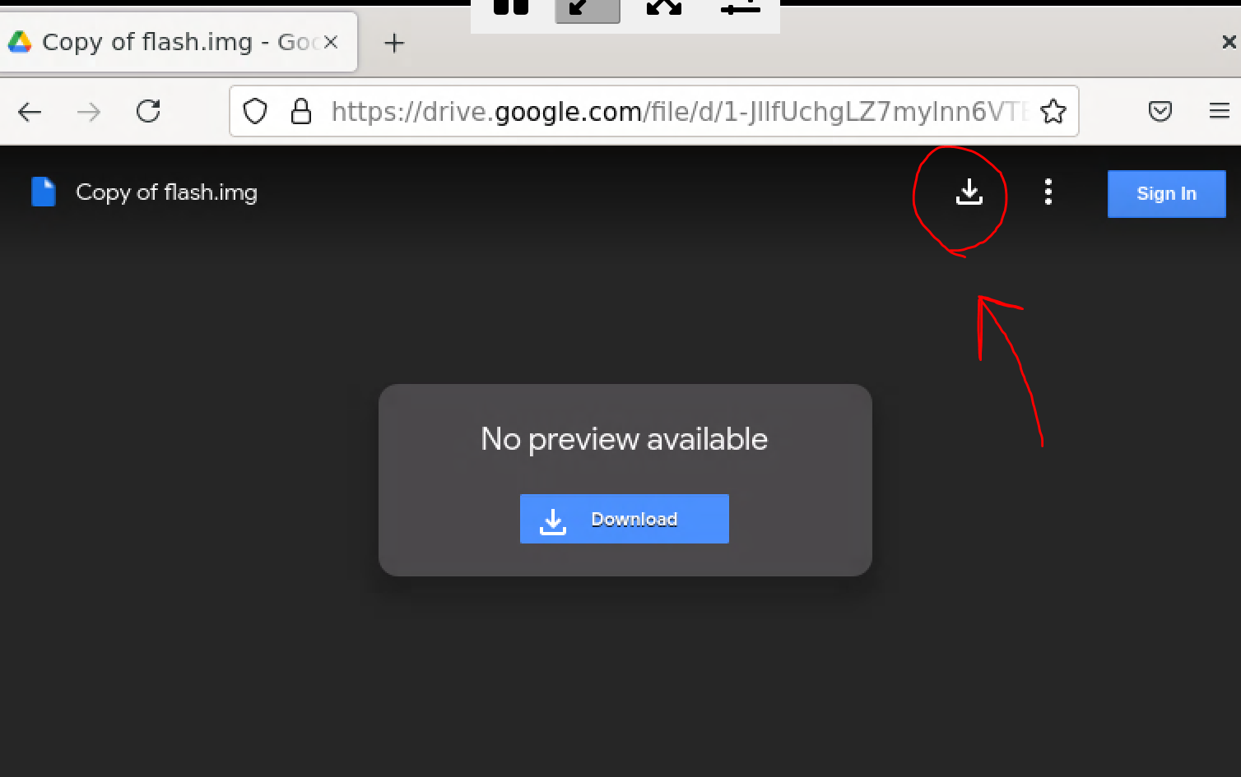
Getting the file
Now lets download the disk image we’ll be working on:
Open up Google chrome or Firefox on FastX and search the link below:
https://drive.google.com/file/d/1-JllfUchgLZ7mylnn6VTErrktYXuzdZE/view?usp=sharing
Download the image
Now back to the Autopsy window!

Slide 6

Setting a Case
Let’s start by creating a new case.
Enter a name for the case you are creating.
For the Directory click on browse and go to the “home” category

Slide 7
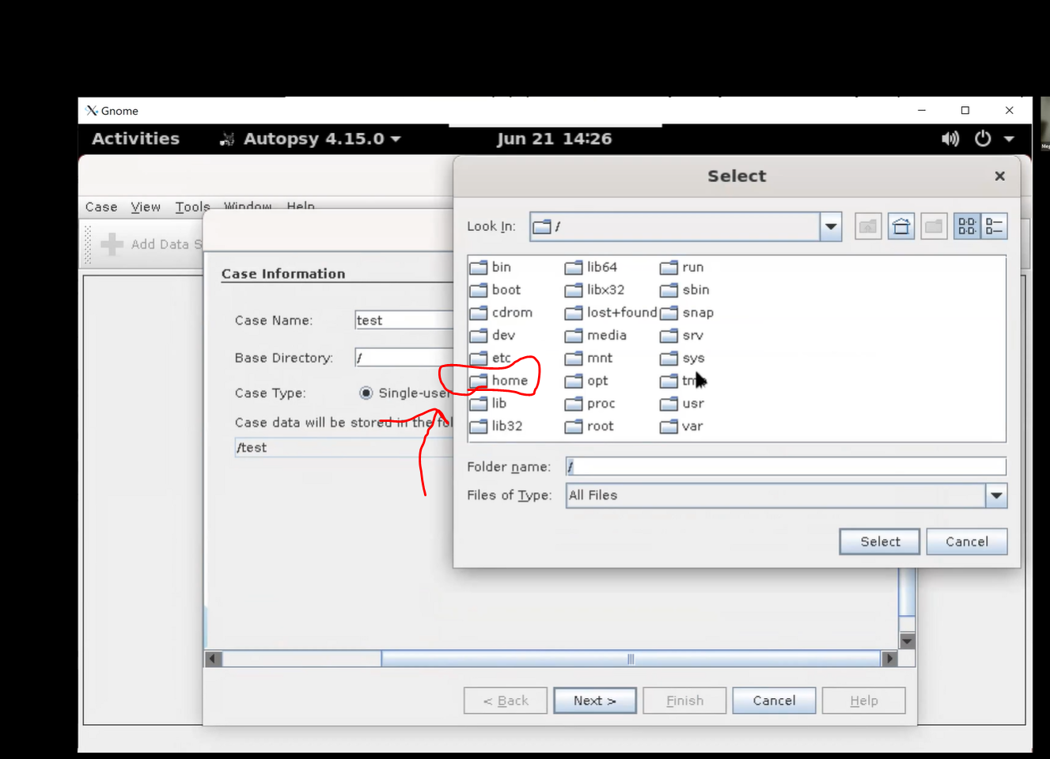
Directory Page
Notes:
After clicking on the home folder, access the folder linked to your nyu emails..
From there access the downloads file

Slide 8
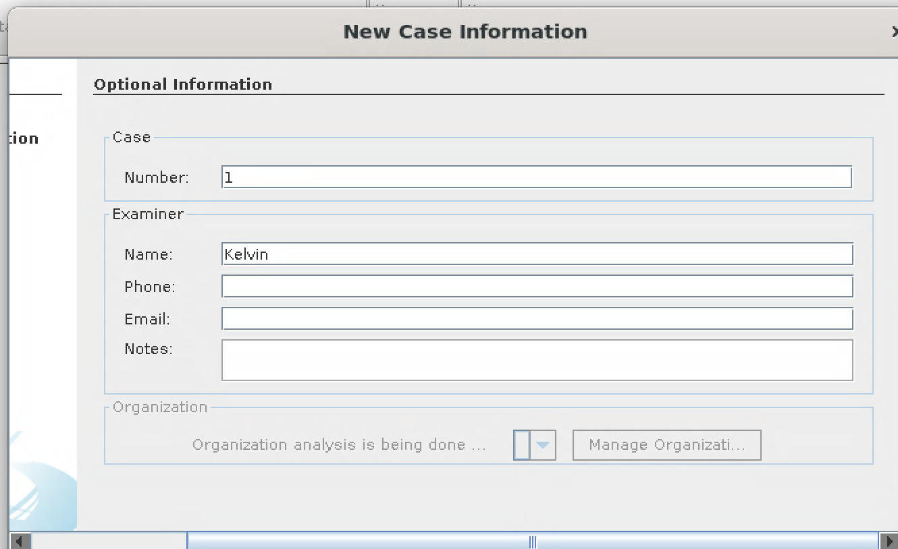
cASE iNFORMATION
Click on Finish when done!
Notes:
You’ll then be prompted by a page to add new case information. This is completely optional but I like to add a case number and Examiner name to keep my cases organized.

Slide 9
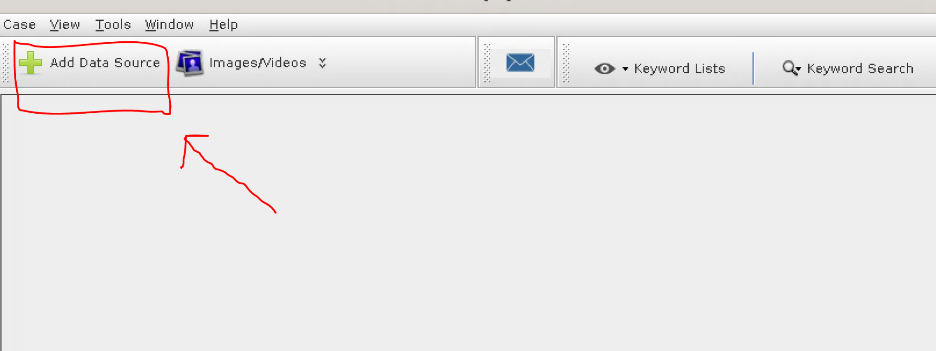
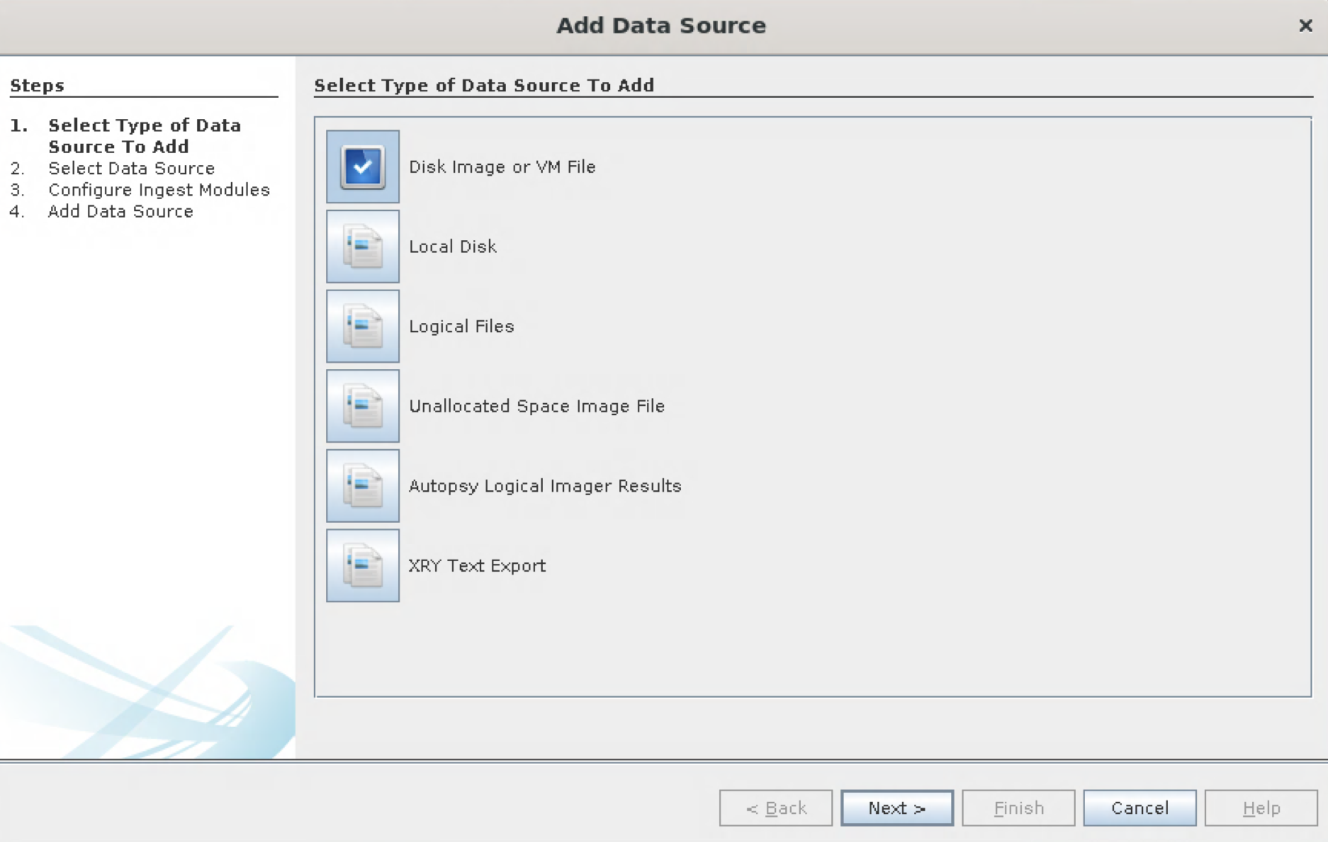
Adding Data Source
Click on the green plus sign on the left hand side of the bar tab
Click on Disk image or VM File
When asked for the path on the following page click on browse and go the the downloads section
There we can find the image file we downloaded earlier
Notes:
Since we’re working with an image, we’re going to Click on Disk image or VM File

Slide 10
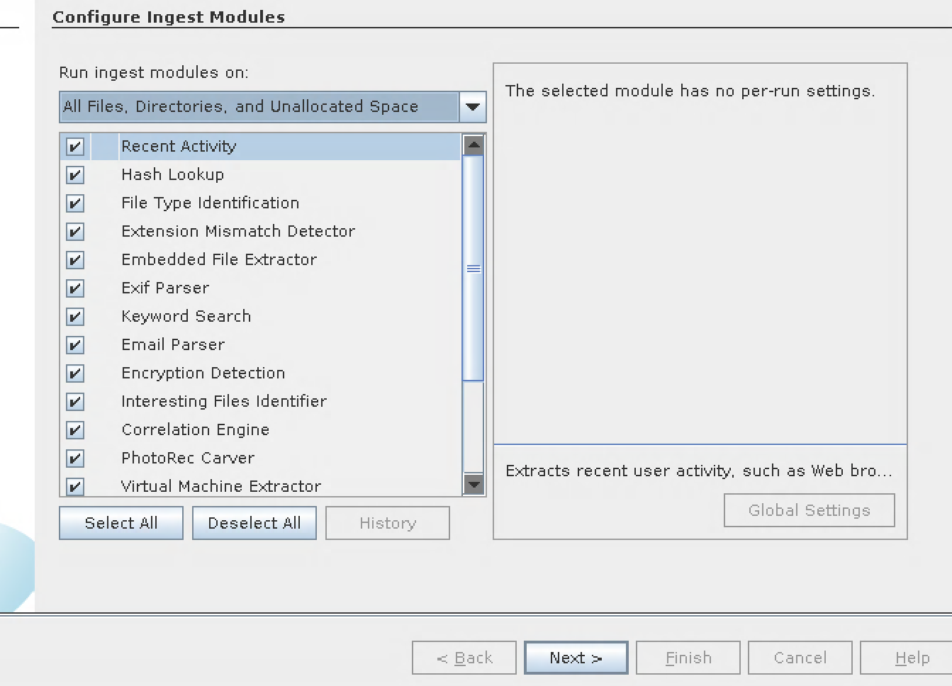
Modules page
Notes:
There should be a bunch of categories checked off

Slide 11

ANALYZING the case
The deleted files are on the bottom left and are in red color.
To download a file , you hit export and then download the file.

